Slide 1
Understanding Strings and String Methods in Python
A Comprehensive Guide

Slide 2
What is a String in Python?
A string is a sequence of characters enclosed within single, double, or triple quotes.
Example: 'Hello, World!', "Python", '''Multiline String'‘’.
Strings are immutable, meaning they cannot be changed after creation.

Slide 3
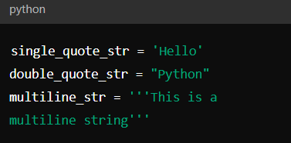
Creating Strings in Python
Single quotes: 'Hello'
Double quotes: "Python"
Triple quotes for multiline: '''This is a multiline string'''

Slide 4
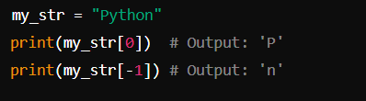
Accessing Characters in a String
Strings are indexed, allowing access to characters using indices.
Index starts at 0 and go in both direction positive and negative.

Slide 5
Common String Methods in Python
Introduce key methods: len(), lower(), upper(), strip(), split(), replace(), find(), join(), startswith(), endswith(), count().
Mention that these methods return new strings and do not modify the original string.

Slide 6
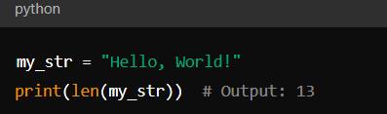
len() Method
Returns the length of a string.

Slide 7
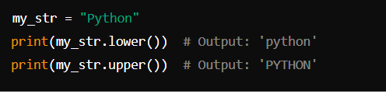
lower() and upper() Methods
lower(): Converts all characters to lowercase.
upper(): Converts all characters to uppercase.

Slide 8
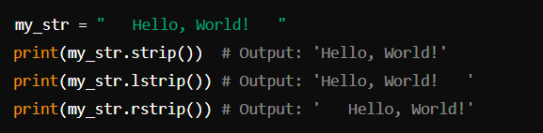
strip(), lstrip(), rstrip() Methods
strip(): Removes leading and trailing whitespace.
lstrip(): Removes leading whitespace.
rstrip(): Removes trailing whitespace.

Slide 9
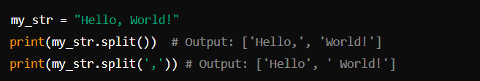
split() Method
Splits a string into a list of substrings based on a delimiter.
Default delimiter is space.

Slide 10

join() Method
Joins elements of an iterable (e.g., list) into a single string with a specified separator.

Slide 11

replace() Method
Replaces occurrences of a substring with another substring.

Slide 12
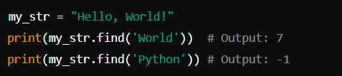
find() Method
Returns the index of the first occurrence of a substring. Returns -1 if not found.

Slide 13
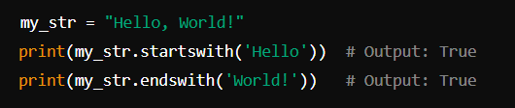
startswith() and endswith() Methods
startswith(): Checks if a string starts with a specified prefix.
endswith(): Checks if a string ends with a specified suffix.

Slide 14

count() Method
Counts the occurrences of a substring in a string.

Slide 15
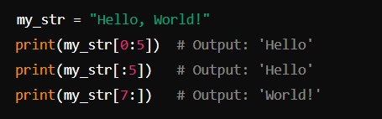
String Slicing
Extracts a substring using a range of indices.

Slide 16
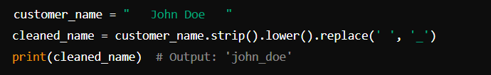
Business Use cases
Use Case1: Data Cleaning and Preparation
Scenario: Cleaning up customer data imported from different sources.
Methods Used: strip(), lower(), replace()
Problem: Customer names have extra spaces and inconsistent capitalization.

Slide 17
THANK YOU
Happy learning!

